Slide 1
Aspen Simulation: Liquid-Liquid Extraction, Filtration, Membrane Separation
Team 1

Slide 2
Table of Contents
Overview of Separation Methods
ASPEN Simulations
Liquid-Liquid Extraction
Filtration
Membrane

Slide 3
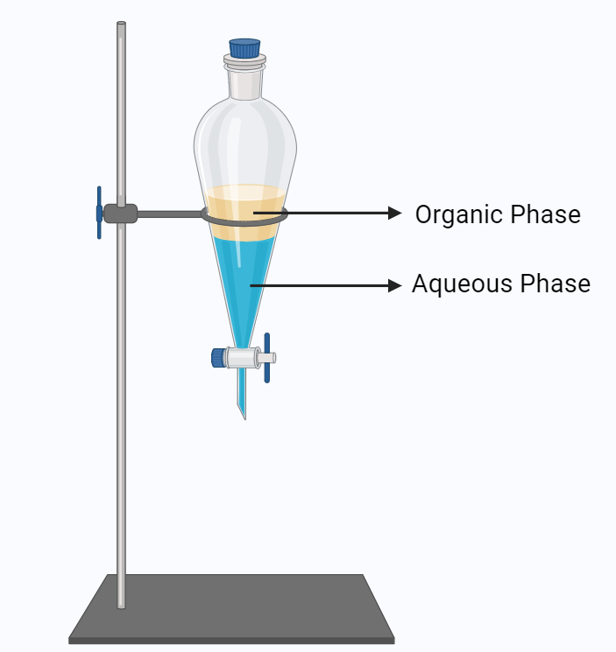
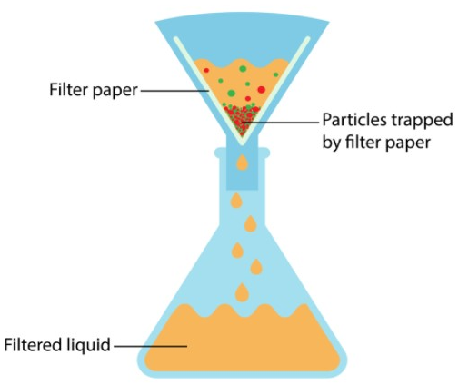
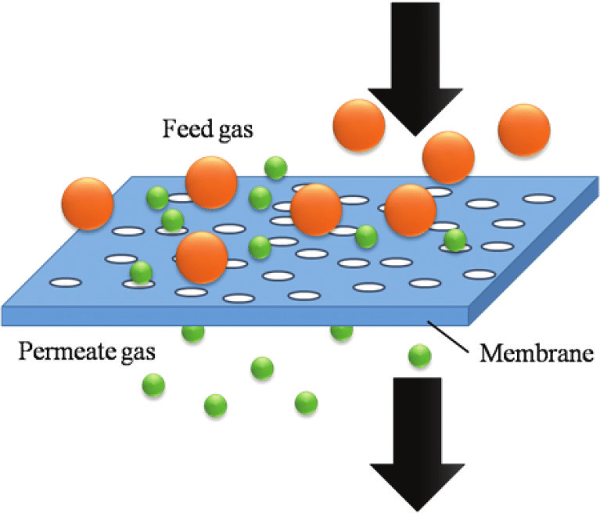
Separation Methods
Liquid-Liquid Extraction
Filtration
Membrane
Process in which a solute of interest is separated based on polarity using two immiscible liquid phases.
Process in which solid particles are removed from a liquid or gaseous fluid using a filter.
Separation of particulates in a gaseous or liquid feed according to size and permeation rates.
Figure generated by bioRENDER
Figure generated by Classnotes123
Figure generated by Polymer Chemistry

Slide 4
Introduction Liquid-Liquid Extraction
The solute of interest will partition/dissolve into phase with similar polarity.
Used when solutes have very small differences in BP or are temperature sensitive.
Also known as, Partitioning or Solvent Extraction.
Figure generated by bioRENDER

Slide 5
Liquid-Liquid Extraction Using Aspen

Slide 6
Liquid-Liquid Extraction Properties
Octanol-Water Partition Coefficient (Table 11.4-1, Sandler)
Octanol-Water Partition Coefficient using infinite-dilution activity coefficient of solute in water (Equation 11.4-13, Sandler)
Sandler, S. Chemical, Biochemical, and Engineering Thermodynamics; Wiley, 2016.
Notes:
UNIQUAC: In general is the best for nearly types of liquid mixtures that are not polymers or electrolytes
Margules, van Laar, and NRTL: good nonpolar/nonpolar mixtures, OK for mixtures with polar compounds but only if these do not deviate too much from ideality, Not recommended for strongly polar/polar mixtures
Flory-Huggins Model: Polymers
The infinite dilution activity coefficient (γi∞) is often applied to characterize solvent–solute interactions, and, when accurately predicted, it can also serve as an early-stage solvent selection tool.

Slide 7
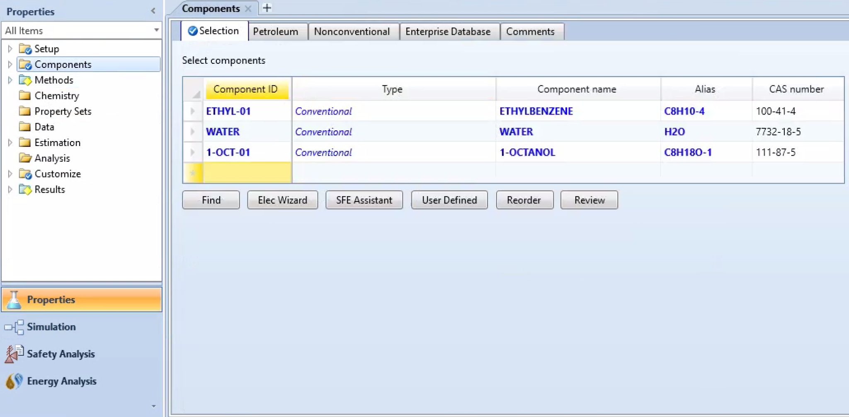
Decanter (Single Stage Liquid-Liquid Extraction)
Decanter can perform Liquid-liquid equilibrium and Liquid-free-water calculations
Goal: Extraction of Ethylbenzene in water using n-octanol as a solvent.
Sandler, S. Chemical, Biochemical, and Engineering Thermodynamics; Wiley, 2016.

Slide 8
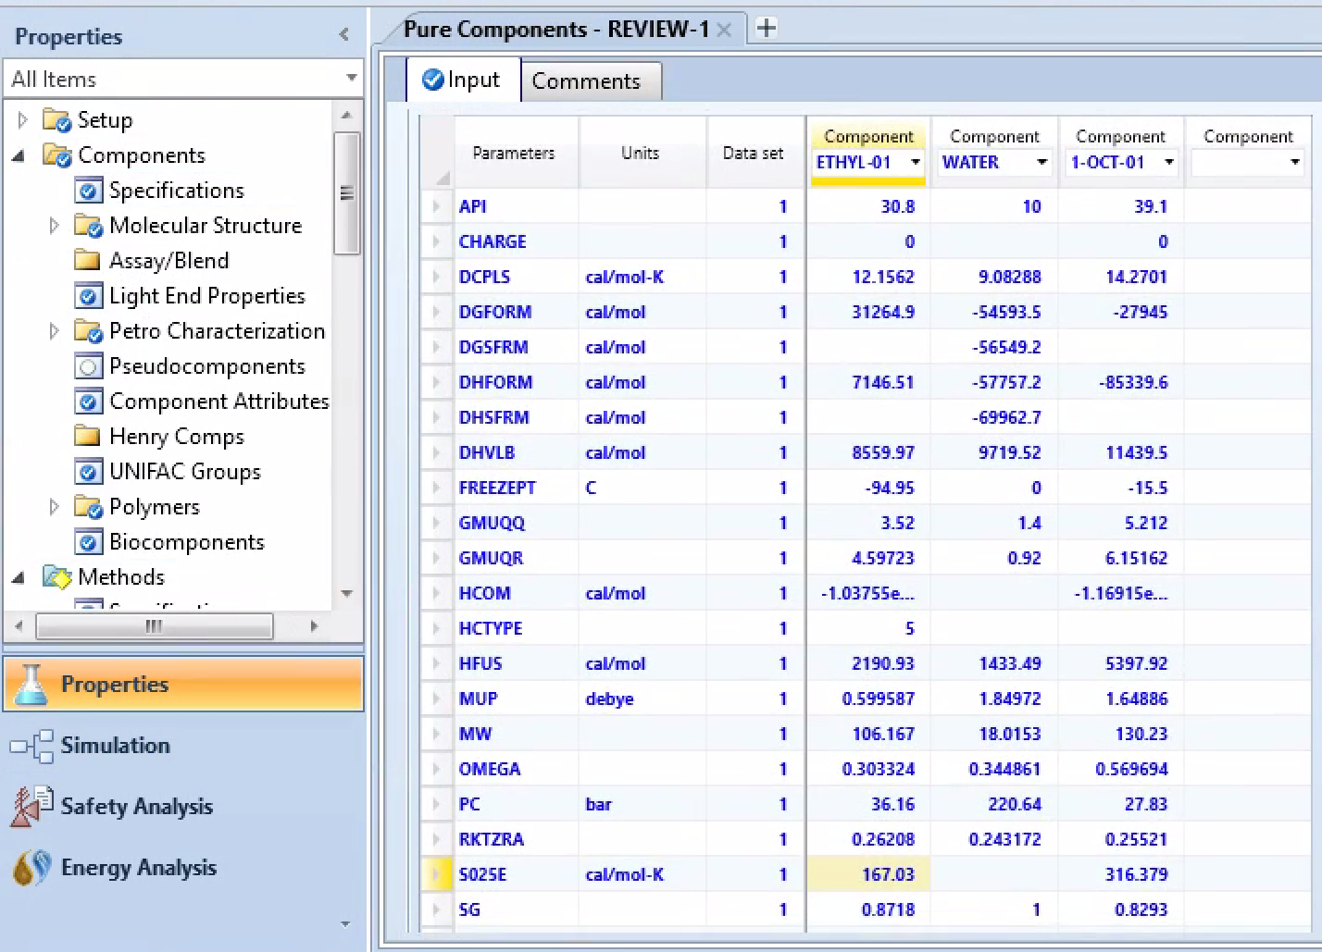
Decanter Simulation Set Up

Slide 9
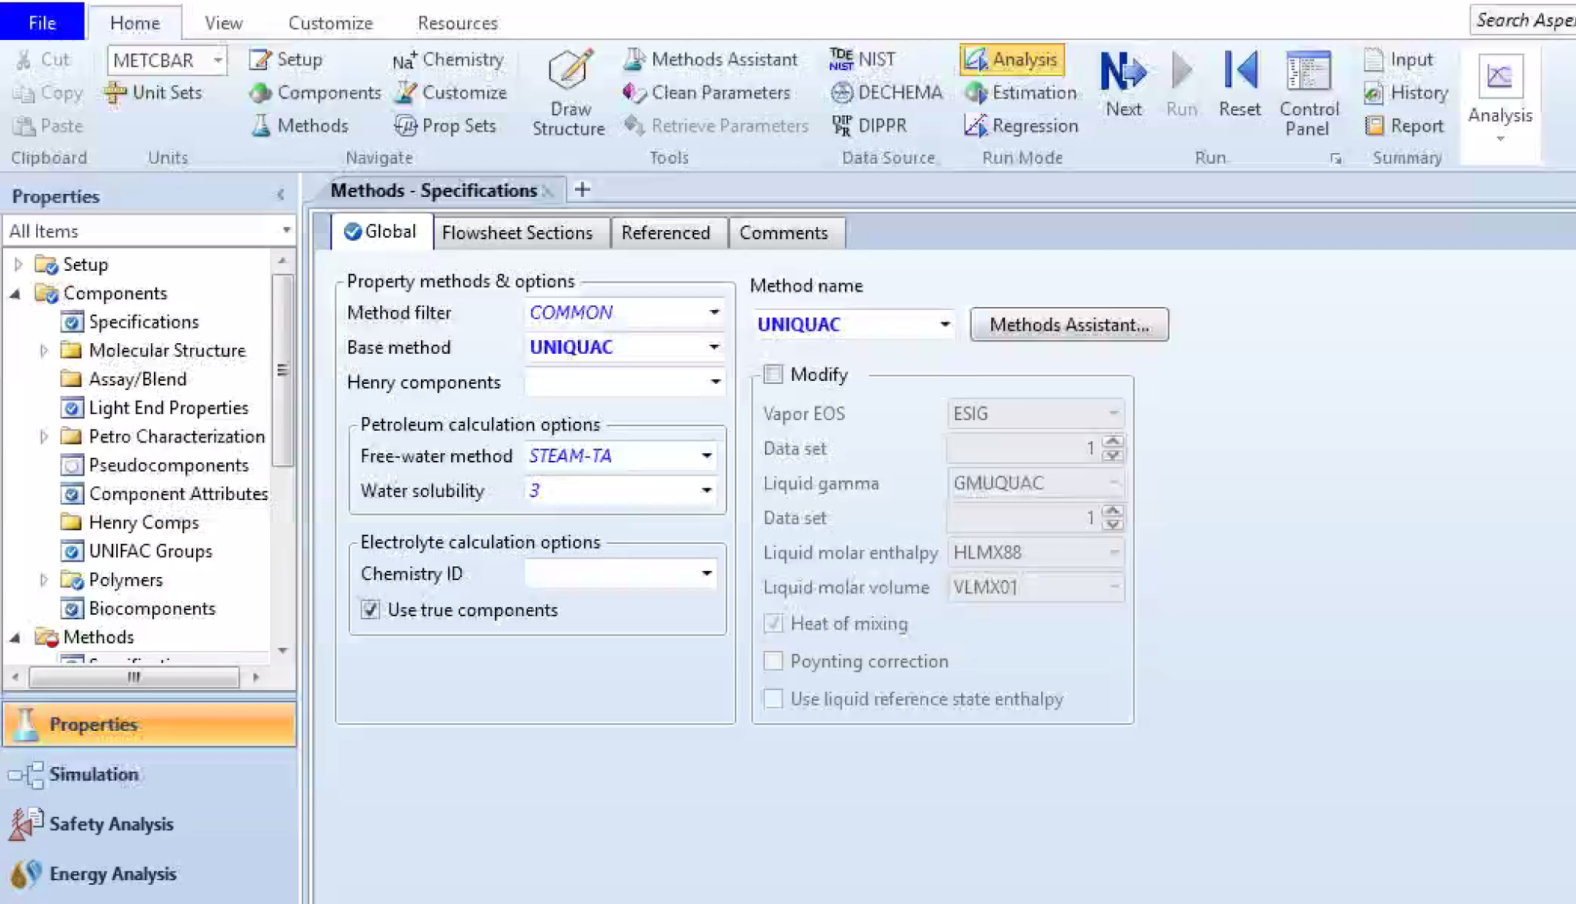
Decanter Simulation Set Up
Common Property Methods: UNIQUAC, NRTL, van Laar model, Margules,
Flory-Huggins
Sandler, S. Chemical, Biochemical, and Engineering Thermodynamics; Wiley, 2016.

Slide 10
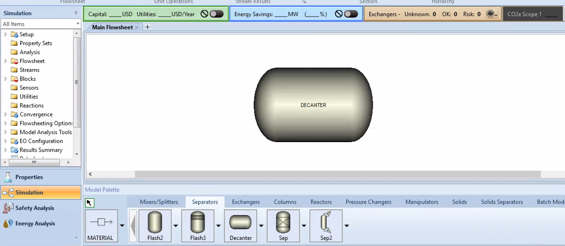
Decanter Simulation Set Up

Slide 11
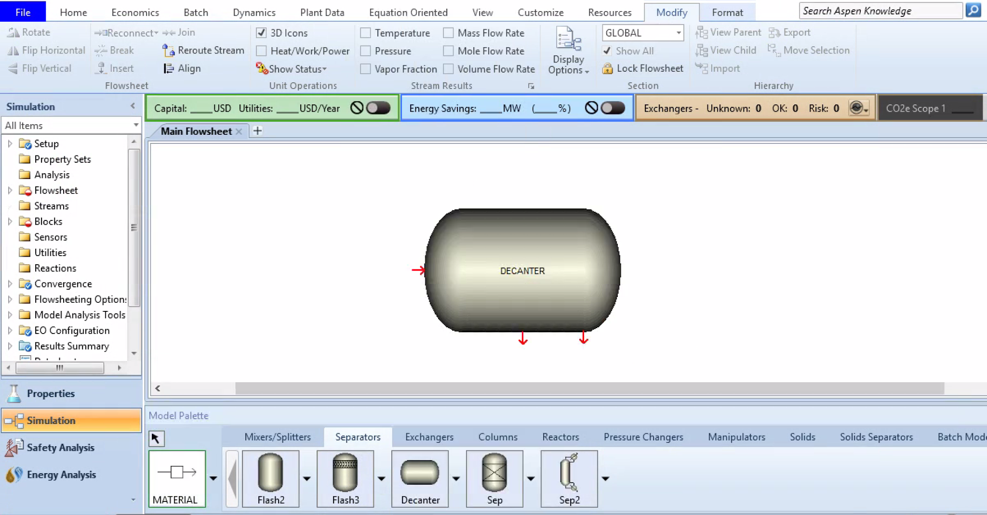
Decanter Simulation Set Up
Feed Stream
More Dense
Less Dense

Slide 12
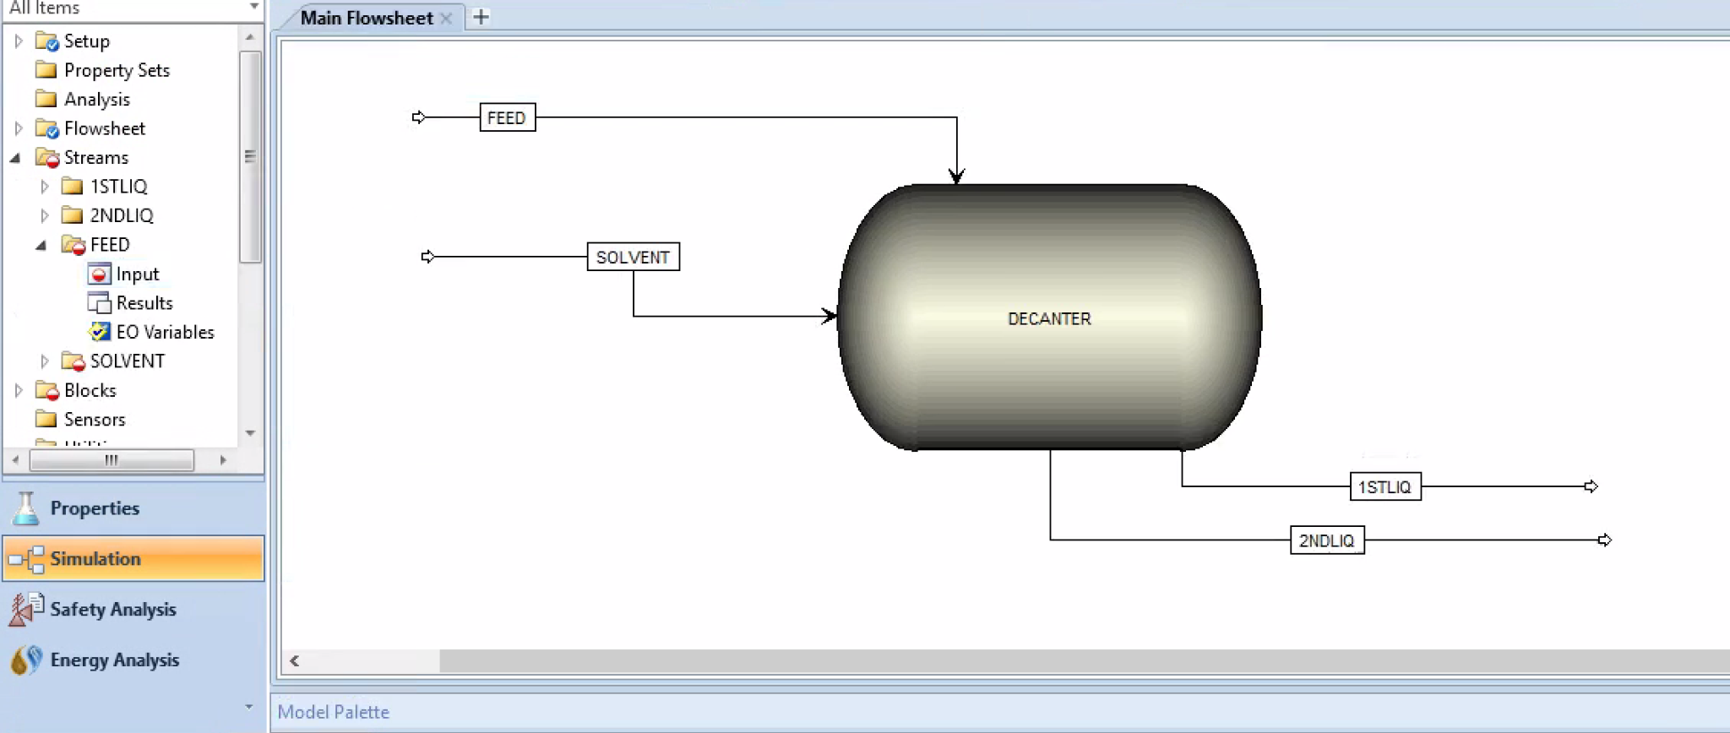
Decanter Simulation Set Up
The decanter will mix and separate the solvent and feed

Slide 13
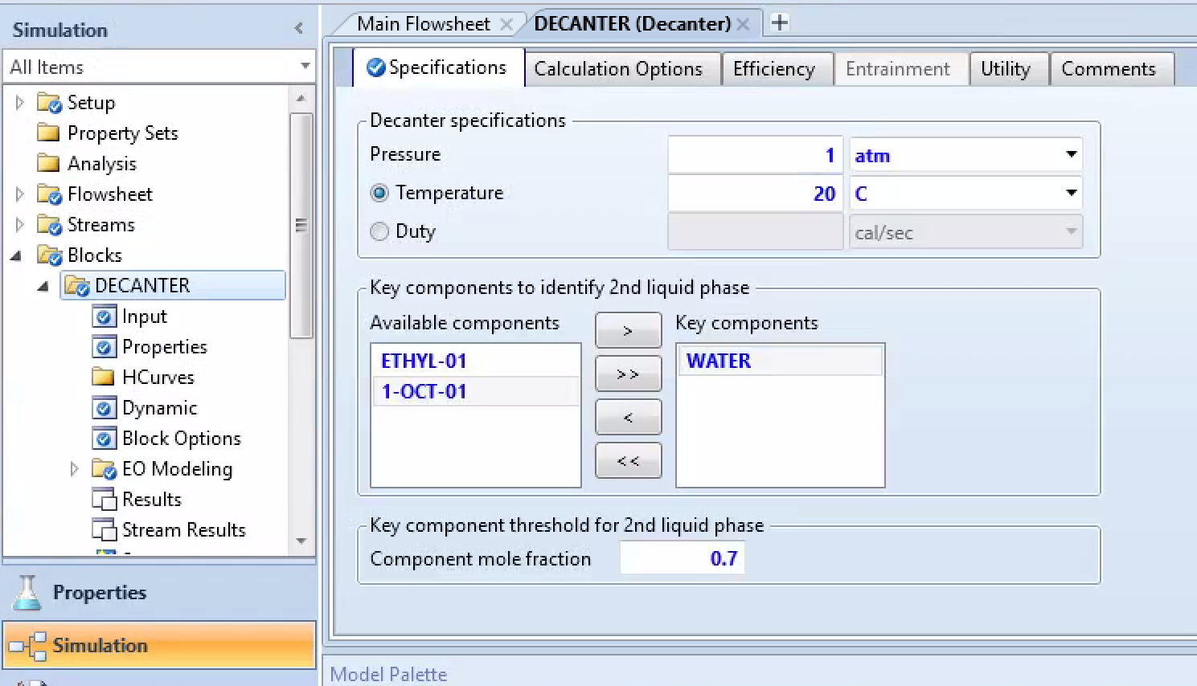
Defining Variables - Decanter Block

Slide 14
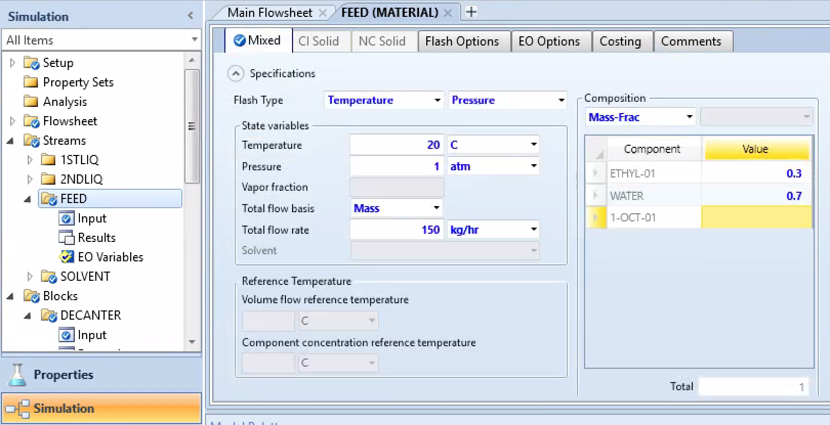
Defining Variables - Feed

Slide 15
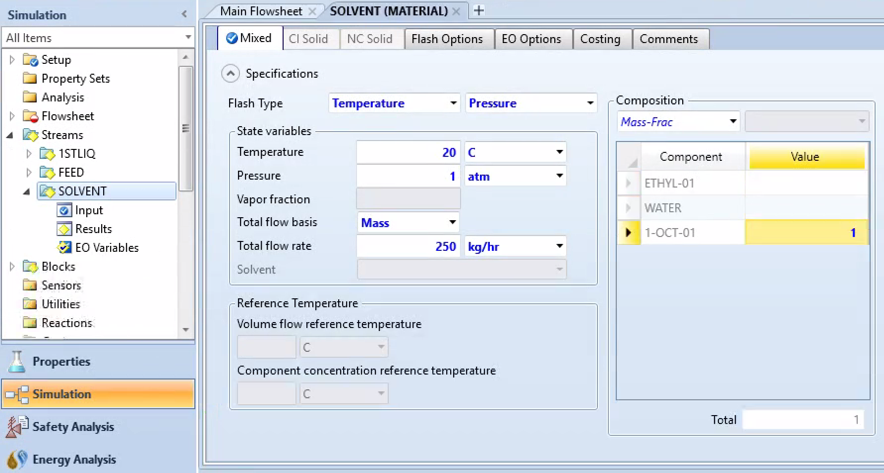
Defining Variables - Solvent

Slide 16
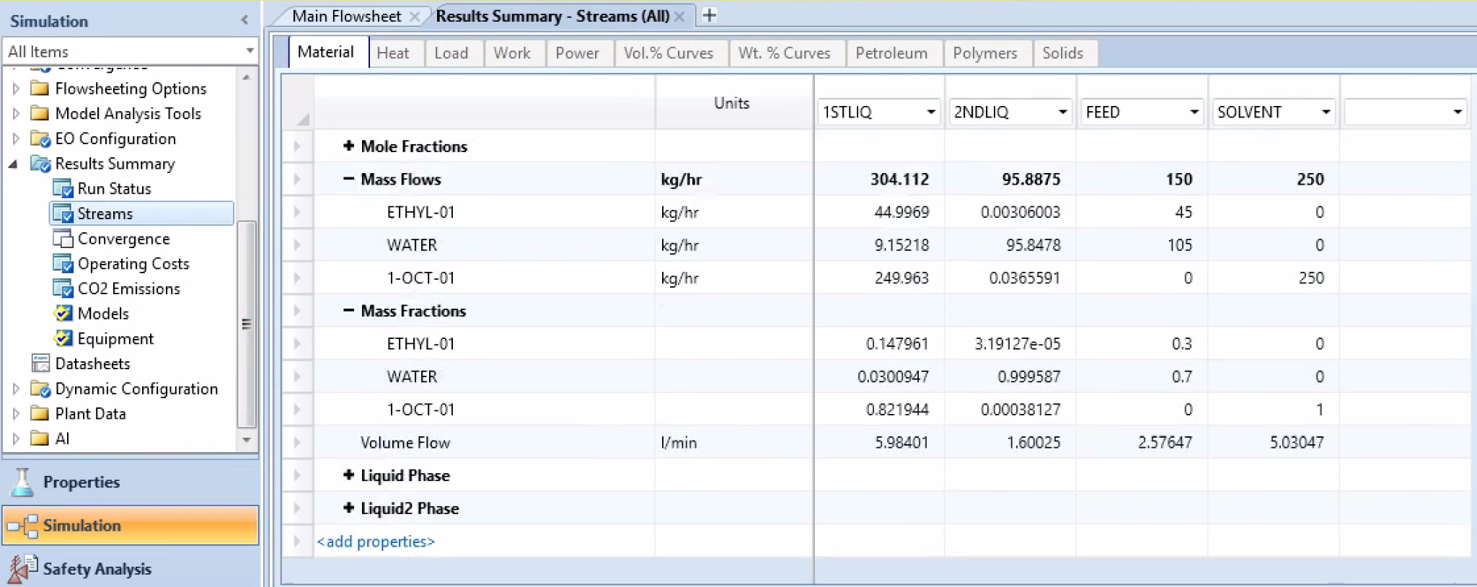
Simulation Run & Results

Slide 17
Alternative Simulations for Liquid-Only Separation
Program | About | Model Palette Location
Multi-Stage Liquid-Liquid Extraction (ASPEN) | Similar theory and concept to Decantor, Use LLE data/graph to find number of stages required (Refer to Sandler textbook) | Columns---->Extract (Top Feed: Higher Density stream, Bottom Feed: Lower Density stream)
Batch Distillation (ASPEN) | Separate molecules in solution based on boiling point | Batch Models ------> BatchSep
Reverse Osmosis (ASPEN) | Separate water using pressure gradient through a semipermeable membrane | Solid Separator -----> Filter ------> Cake Filter (A variety of customized models as seen in literature)
Pervaporation (COMSOL MULTIPHYSICS - Available on Virtual Computer Lab) | Separation using vacuum, where small molecules permeate through membrane based on solubility and diffusion rate | Cannot be integrated with Aspen
Dialysis (COMSOL MULTIPHYSICS) | Diffusion based separation (concentration gradient required) | Cannot be integrated with Aspen

Slide 18
Filtration Separation via ASPEN

Slide 19
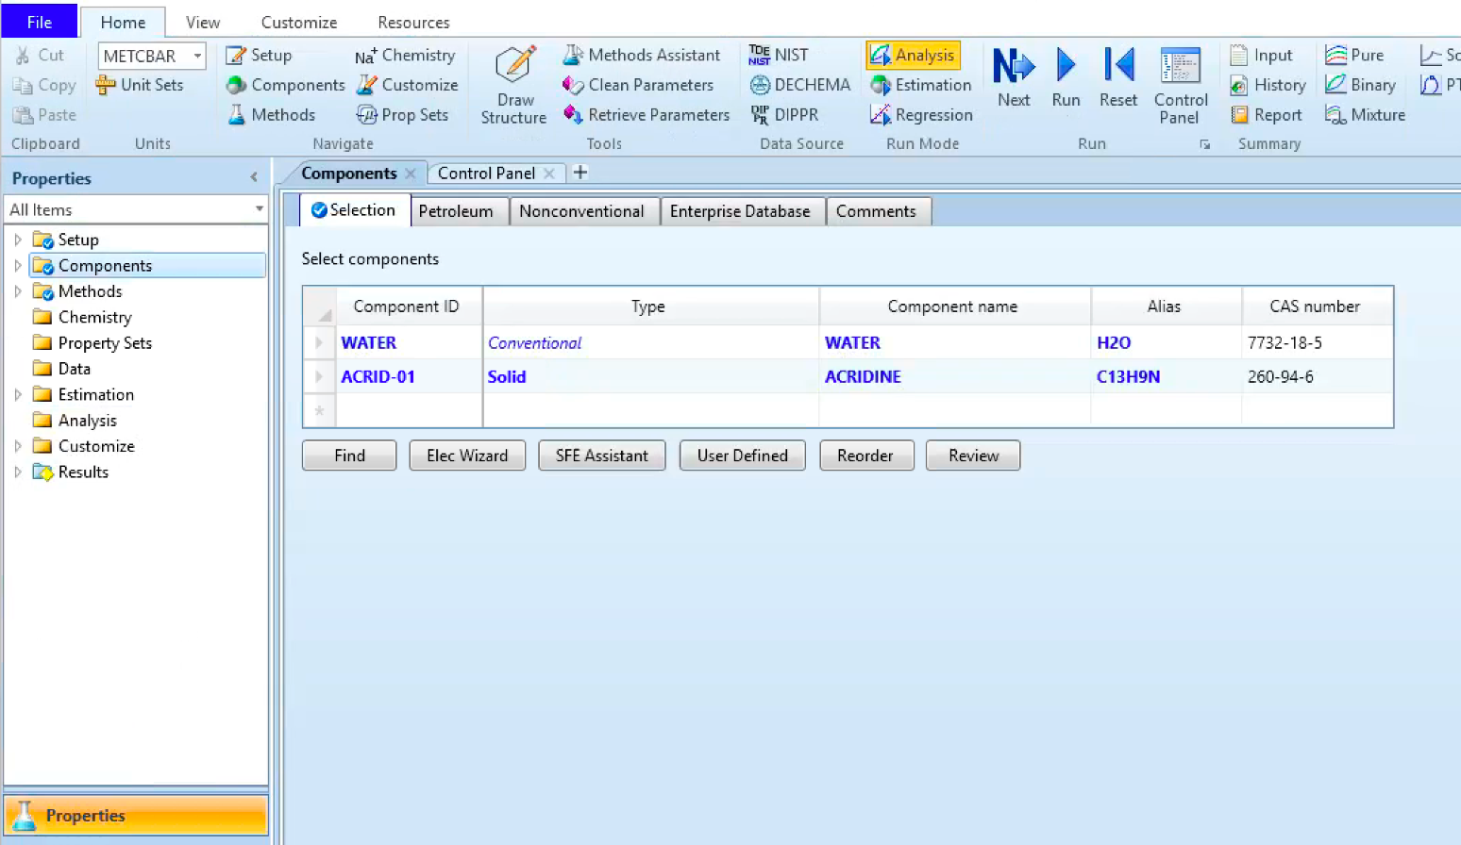
Filtration Simulation Set Up
Goal: Separate Acridine (organic solid) from water via filtration using the ASPEN filter.

Slide 20
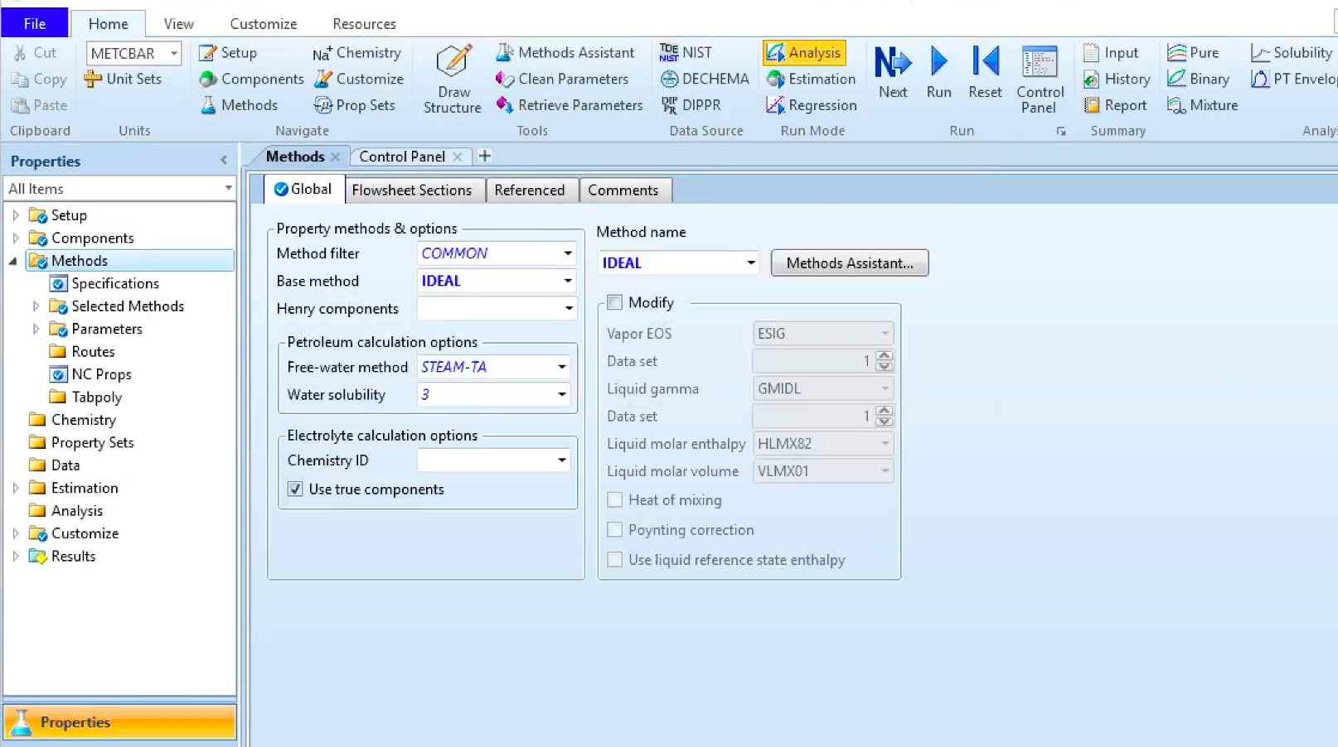
Filtration Simulation Set Up

Slide 21
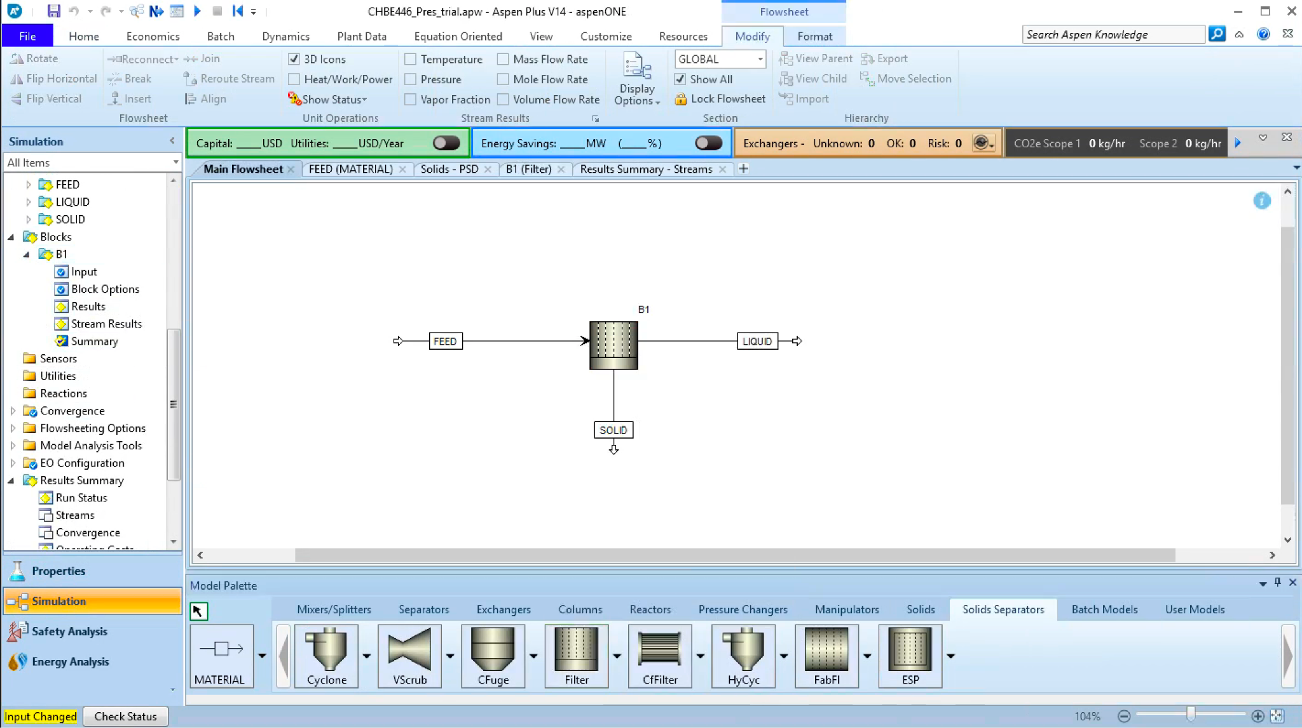
Simulation

Slide 22
Defining Variables - Feed

Slide 23
Defining Variables - Solids

Slide 24
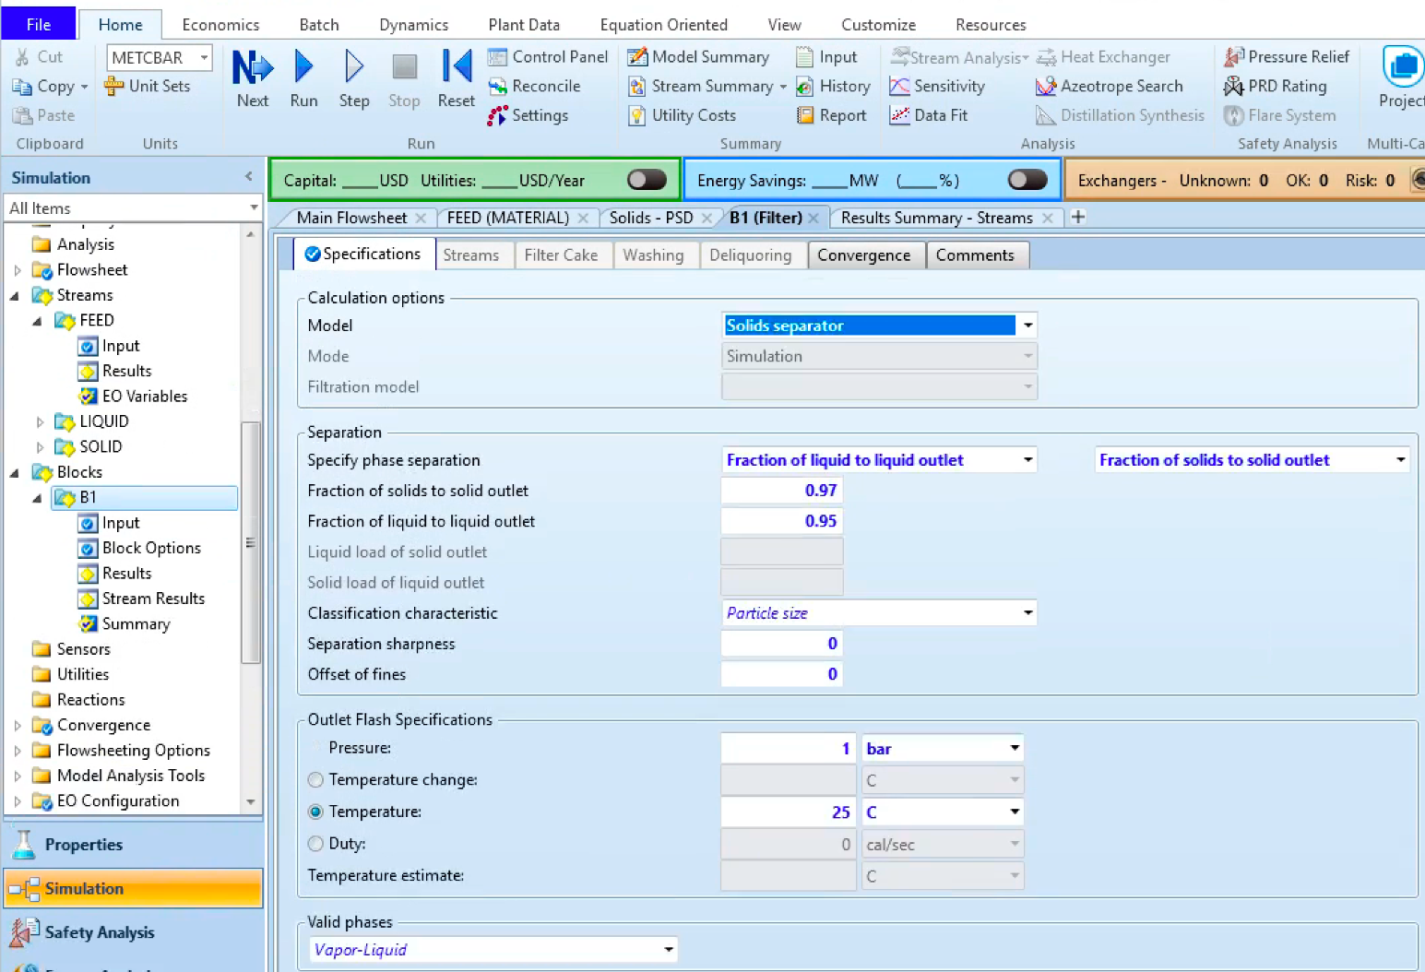
Defining Variables - Filter

Slide 25
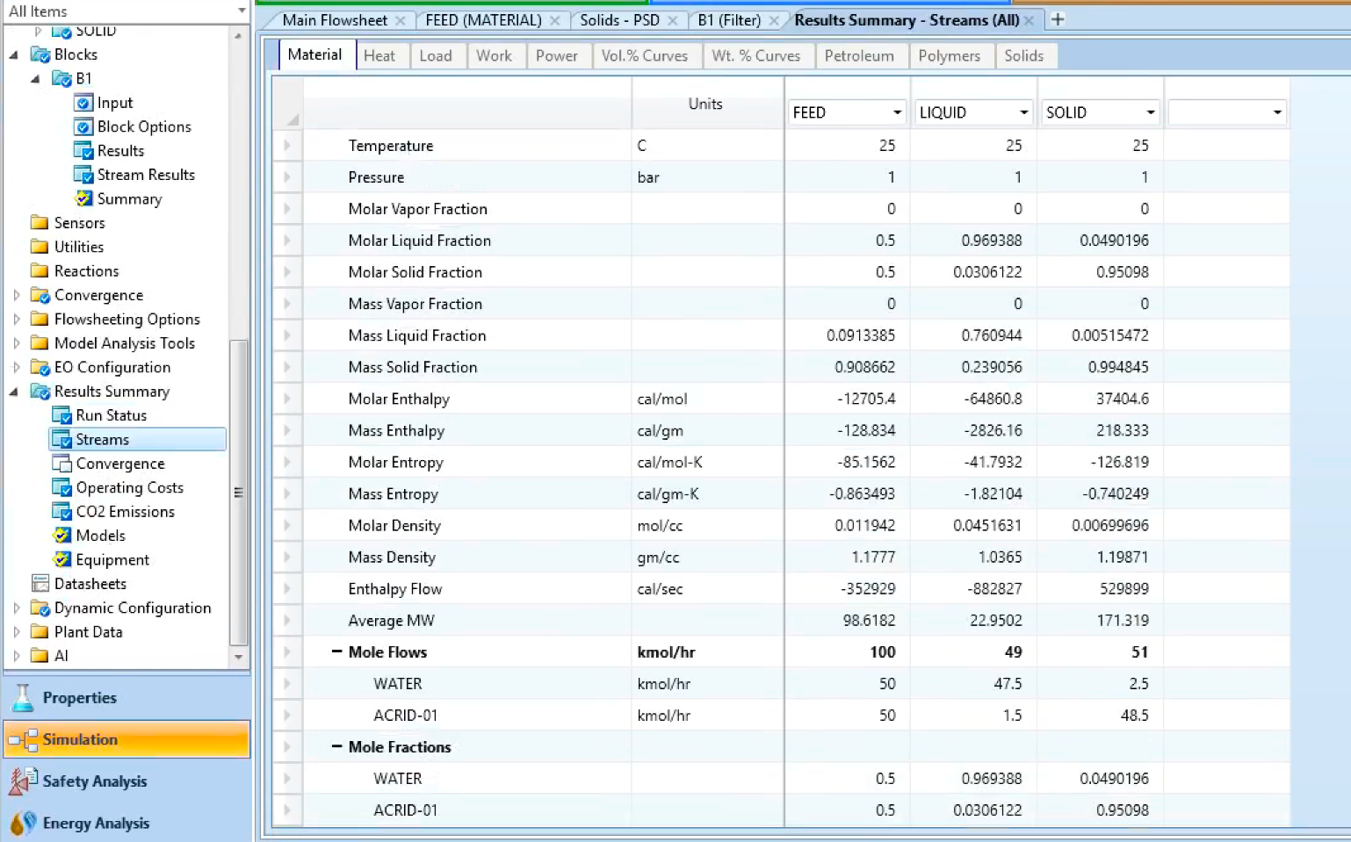
Simulation Run & Results

Slide 26
Membrane Separation via ASPEN

Slide 27
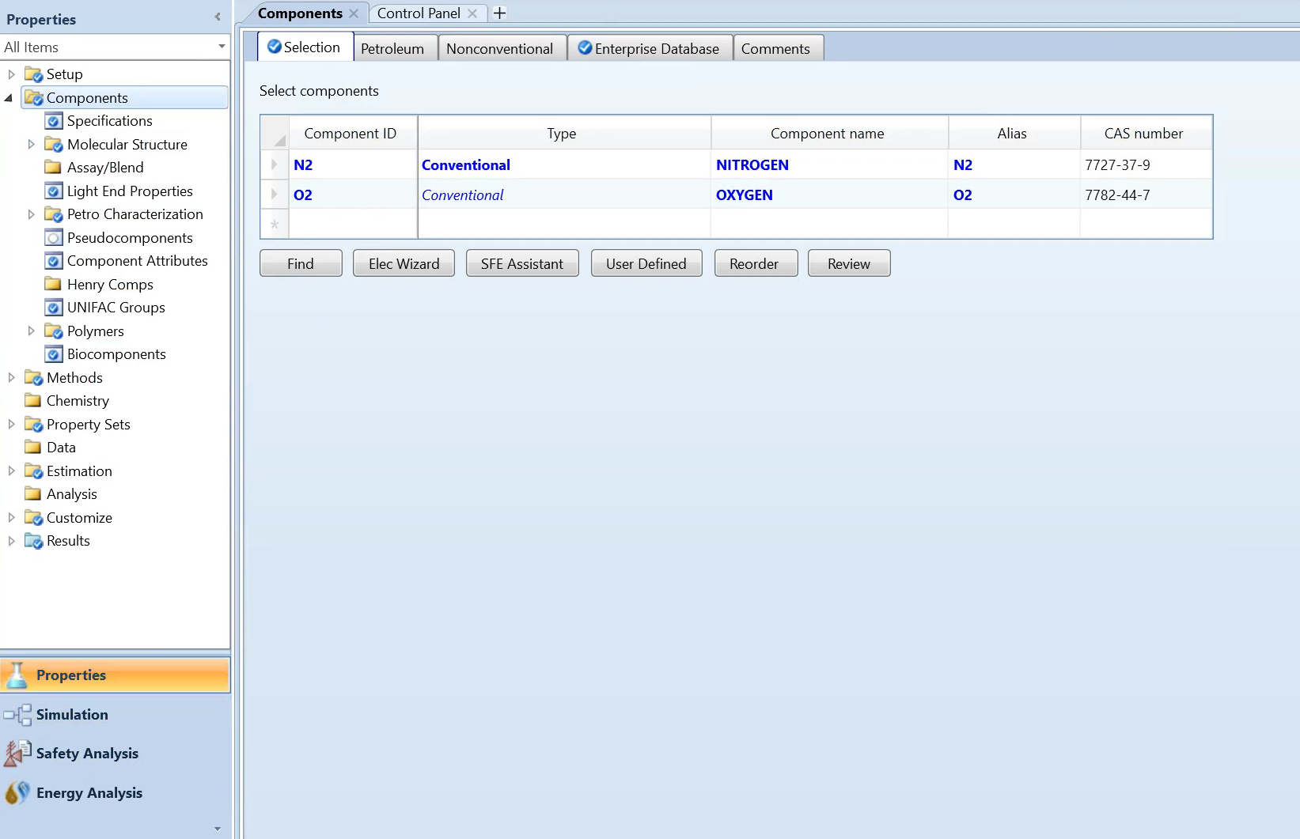
Membrane Simulation Set Up
Goal: Separate oxygen and nitrogen via a semipermeable membrane using the ASPEN separator block.

Slide 28
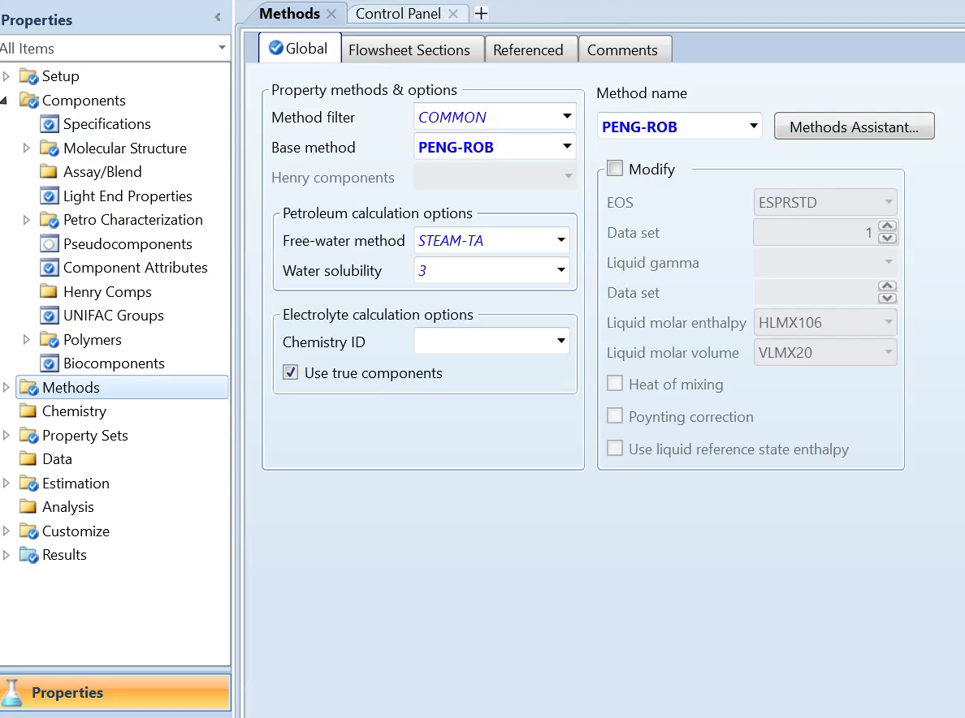
Membrane Simulation Set Up

Slide 29
Simulation

Slide 30
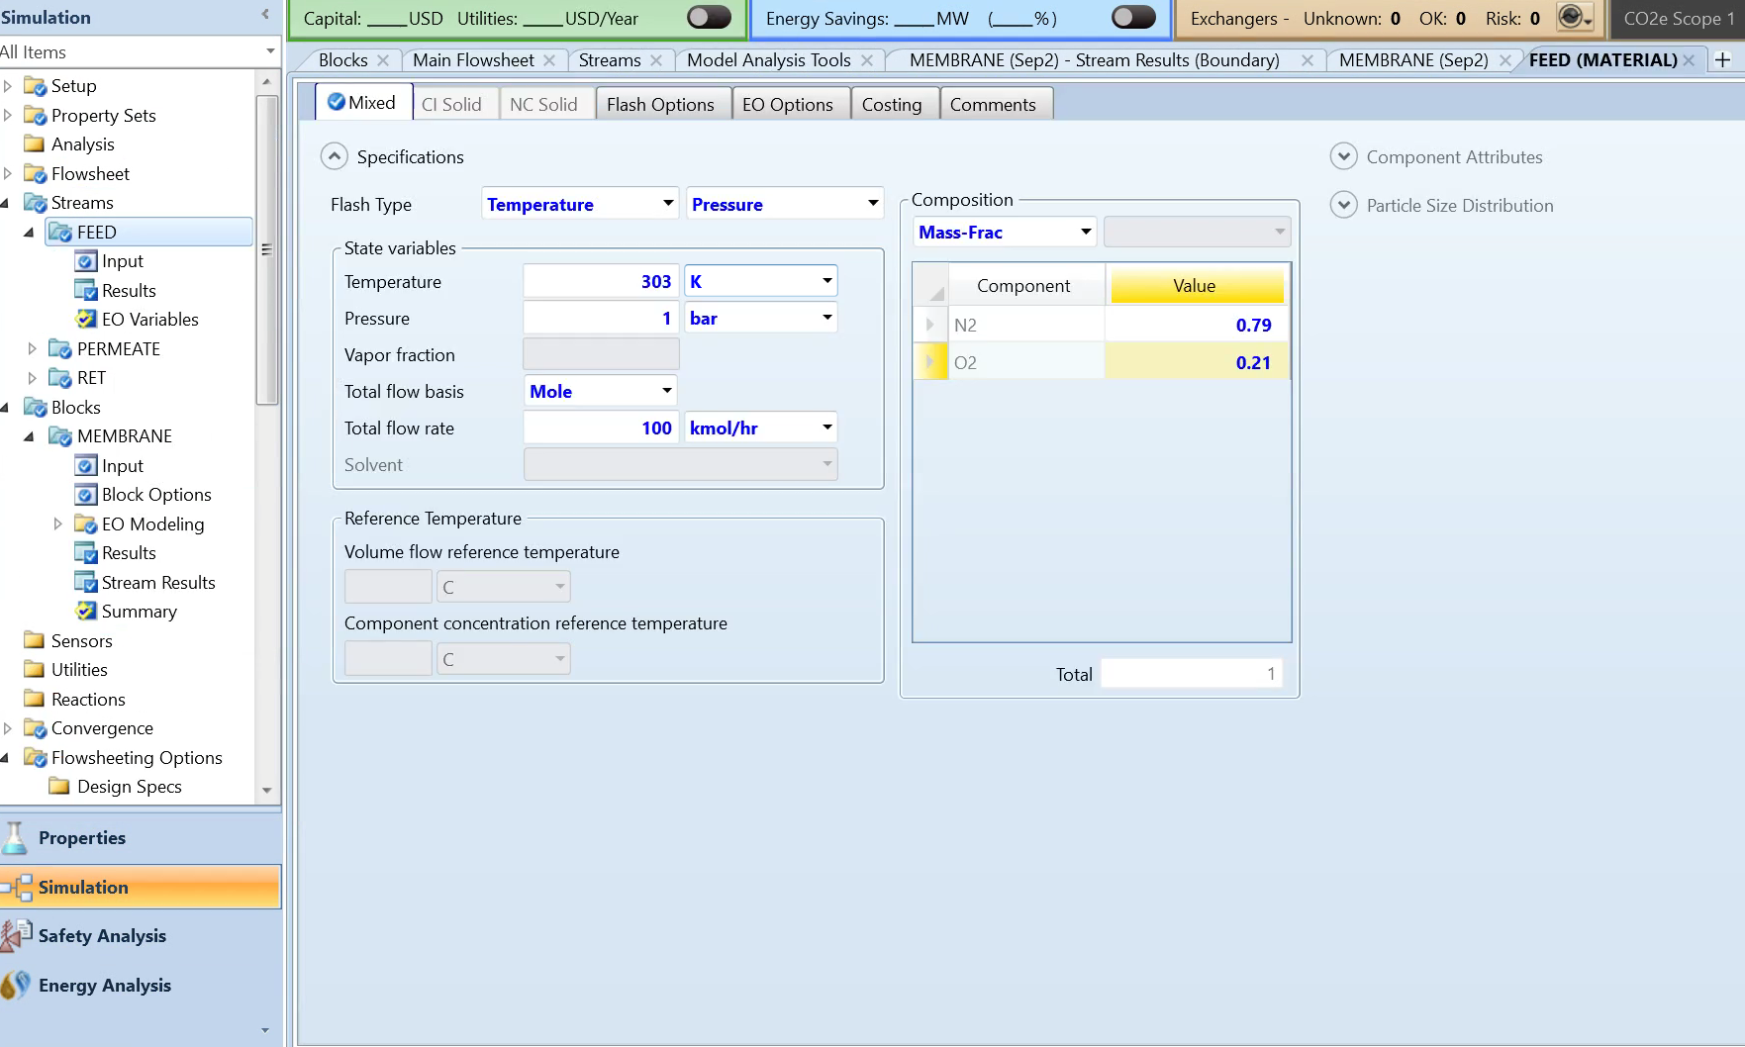
Defining Variables - Feed

Slide 31
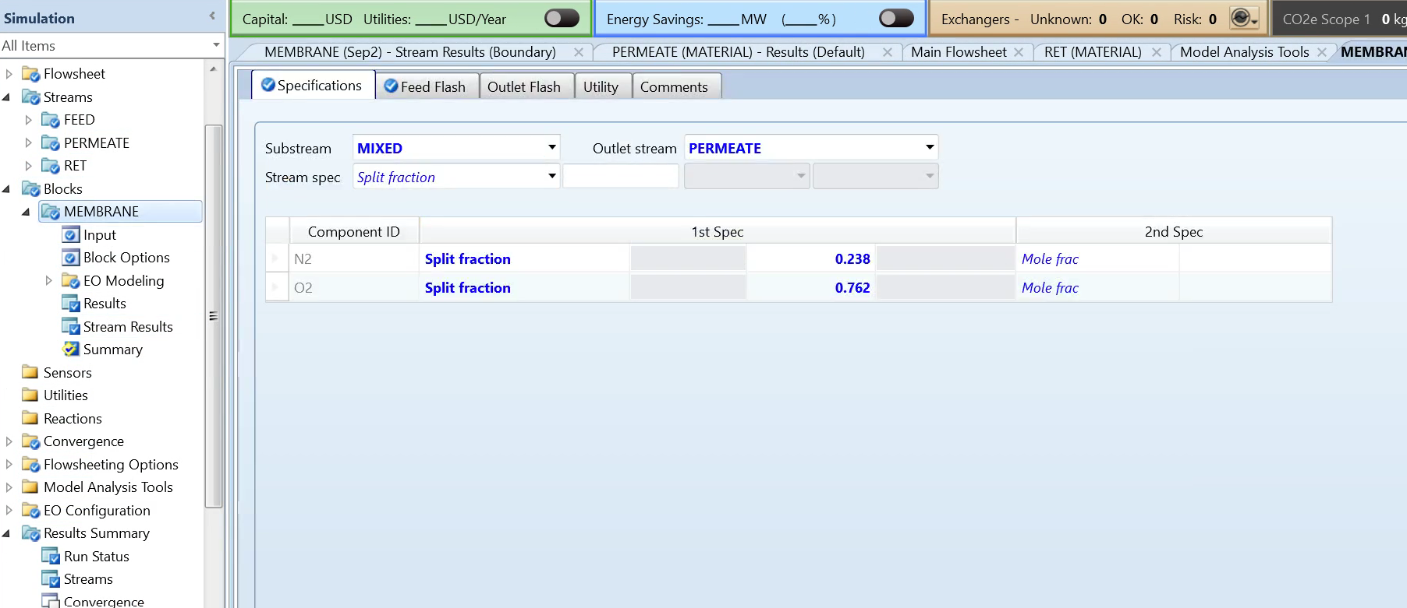
Defining Variables - Membrane

Slide 32
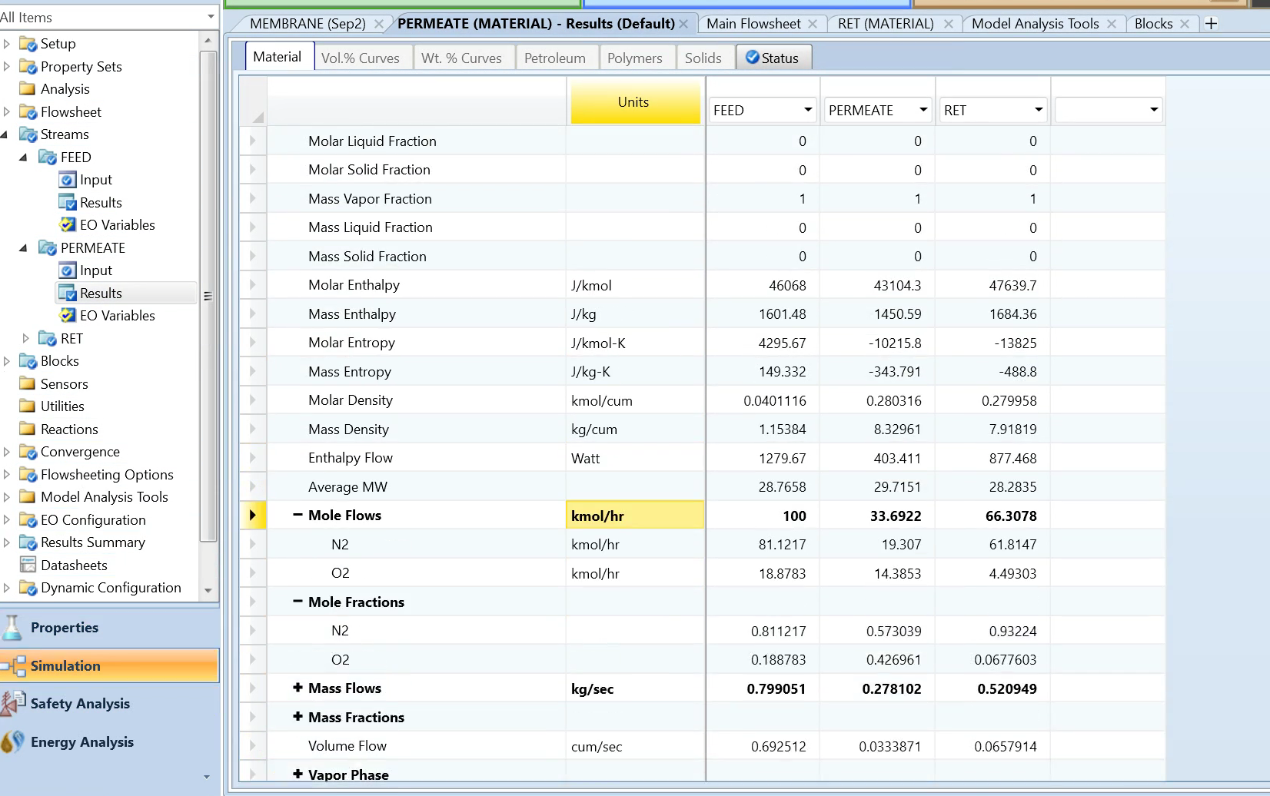
Simulation Run & Results
Retentate: Nitrogen rich
Permeate: Oxygen rich

Slide 33
Questions?

Slide 34
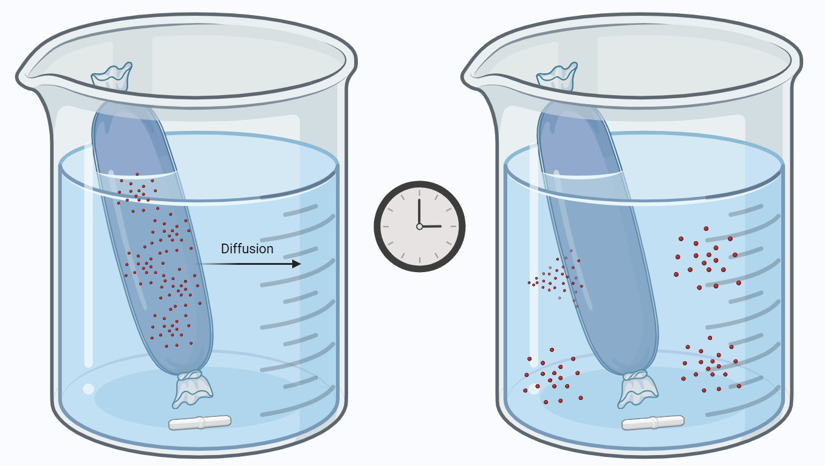
Introduction to Dialysis
Dialysis is commonly used in batch processes to separate small molecules from solution using a concentration gradient.
Small molecules of interest can be recycled upstream/downstream or sold as a product.
𝜏
Figure generated by bioRENDER

Slide 35
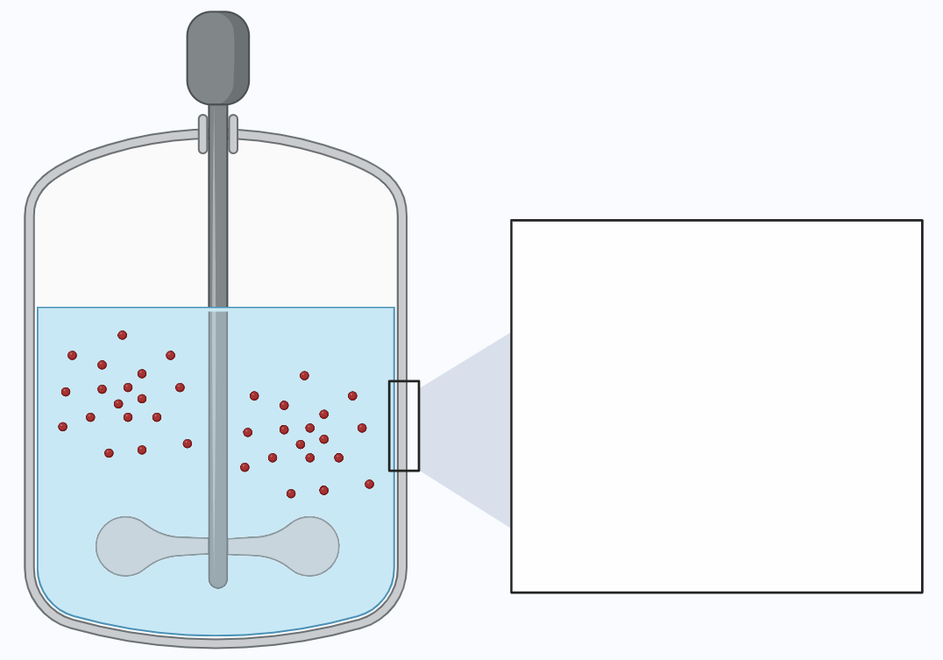
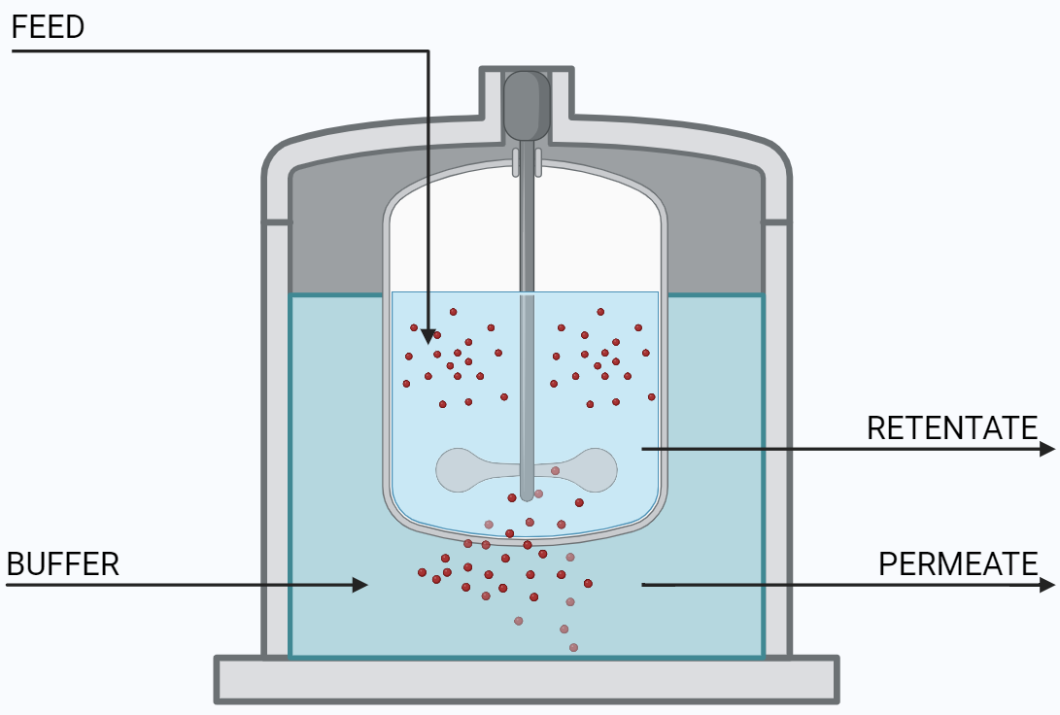
Design of Dialysis as a Batch Processes
Solve for concentration profile and residence time (𝜏) using the Quasi-Steady State Approach
Limitations: Assumptions may not be accurate for process design, diffusion is very slow due to low Surface Area:Volume
Figure generated by bioRENDER

Slide 36
Simulation of Dialysis on Excel
Problem: Find the residence time, volumetric flow rate, and molar flow rate of each stream in the continuous dialysis process
Define: Diffusivity Coefficient (literature), volume of feed compartment, initial concentration of solute in feed stream, target solute concentration in product stream, thickness of permeable membrane
Solve: Concentration profile using Quasi-SS Approach, residence time (𝜏), volumetric flow rate (Volume/Residence Time), molar flow rate of streams using mole balances (volumetric flow rate * concentration of solute)

